Slide 1
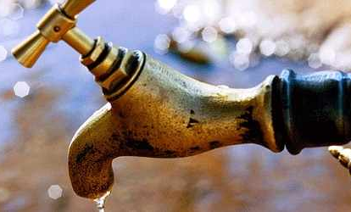
«Water Sector Reform in Kenya »
Trainings 24.-28.8. and 28.9.-2.10.2015

Slide 2
Costs of providing sanitation
Based on „Sector Governance in Urban Sanitation“ e-learning course of Margraf Publishers

Slide 3
Table of Content
  Costs of Sanitation
  Low User & High User Cost Recovery Scenario
  Situation in the real world
  Positive actions

Slide 4
  Costs of Providing Sanitation
  In providing sanitation services, the entities/actors responsible will incur mainly operating costs and capital costs.
  There is great variability across utilities about the percentages that each of these costs represent in the overall cost structure.
  Operating costs: The pollution load – the amount of organic material in the wastewater – is the biggest determinant of treatment costs.
  Capital costs: The costs of the collection network itself are driven largely by the length of the network and the levels of groundwater and rainwater inflow and infiltration into the sewer network. Inflows and infiltration determine the required pipe diameters, holding tank capacities, and so on.

Slide 5
Operating costs (OPEX) of network-based sanitation
Type | Description | Depend on
Operation and maintenance (O & M) | Operation and maintenance cost for the system; the principal components are: Staff Electricity Chemicals Services from third parties Bad debts (see below) | Service area characteristics Operating efficiency Service standards
Bad debts | Billings that are expected to remain uncollectable | Collection efficiency Tariffs relative to ability and willingness to pay

Slide 6
Capital costs (CAPEX) of network-based sanitation
Type | Description | Depend on
Capital Expenditures | Capital costs, including asset renewal and asset expansion, see below
Asset Renewal | Capital expenditures in the system‘s exisiting assets | Condition of the system Investment efficiency Service area characteristics
Asset expanison | Capital investments in network and equipment required to expand level of collection, treatment and disposal | Exisiting coverage level Coverage goals Service standards Investment efficiency
Debt service | Interest and principal payments on loans | Amount of capital expend. Tariff and subsidy policy Financing strategy
Return on capital | Profit can be kept in the company or distributed through dividends | Operating efficiency Tariff policy, Strategy

Slide 7
Costs of on-site sanitation
Type | Description | Depend on
Capital costs | Capital costs to build the on-site facility | Technology, Competition in the sector Service area characteristics
Cost of borrowing | Households that need to finance the on-site facility will have to pay interest | Available finance sources Terms on loans
Emptying service cost | Pit/septic tank emptying services costs: Transport & truck capital cost Fuel cost Administrative cost Discharge fee (or discharge premium!) | Operating efficiency Service standards Discharge standards Service area characteristics
Sludge treatment | Cost to treat the sludge collected and disposed | Operating efficiency Service standards

Slide 8
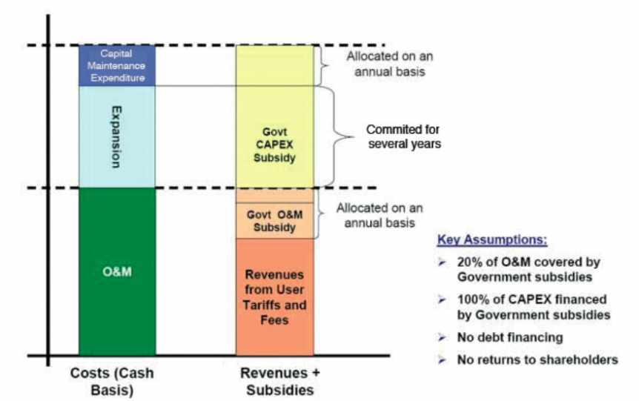
Low User Cost Recovery Scenario
Funds allocation
In Theory
Notes:
When revenues from user tariffs and fees are low, the system suffers because it depends on subsidies, which are usually unreliable.
As shown in the figure, revenues from user tariffs and fees often do not even cover O&M costs.
In many cases the government will promise to provide subsidies on a regular (annual) basis to cover the remaining O&M costs and also to fund asset renewal. In addition, as the expansion of the network requires a more established and longer term commitment, the Government might provide subsidised loans on a longer term basis to cover asset expansion.

Slide 9
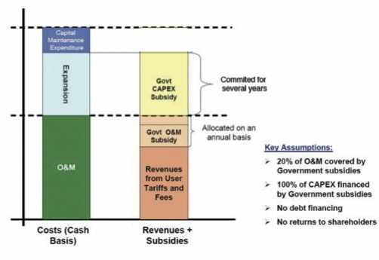
Low User Cost Recovery Scenario
Funds allocation
In practice
Notes:
In practice however, the subsidies promised by the government may not materialise.
The figure shows a typical situation where the government/users has not provided funds for some of the expenditures. Indeed, subsidies are unreliable because they are allocated on a short term (often annual) basis and are dependent on political willingness.
Usually, under this scenario, the quality of service decreases and asset renewal and expansion is limited.

Slide 10
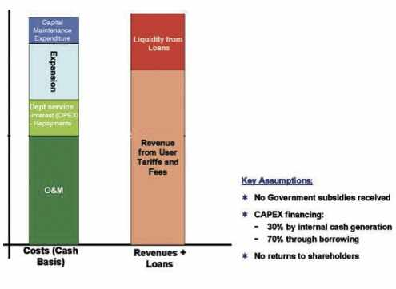
High User Cost Recovery Scenario
Benefits of high
user cost re-
covery scenario
Notes:
The figure illustrates the benefits of a scenario in which the utility is able to cover a higher percentage of its costs from user charges. In this scenario, the government may not have to provide subsidies to cover operating costs nor even capital expenditures.
This means the utility’s revenue stream (and therefore its financial sustainability) is better protected from unpredictable political decisions. Revenues from user tariffs and fees not only cover operating costs, but also part of the expansion of the network.
The higher reliability of funds helps the utility to obtain loans that cover the rest of the needs. Therefore, under this higher cost recover scenario, the utility has a higher security of cash, greater transparency and improved performance of the system. In this scenario, the quality of service will improve and the number of beneficiaries will most likely be increased through network expansion.

Slide 11
  Situation in the real world
  In practice, most utilities will fall somewhere between these two scenarios described before
  However, the closer a utility is to higher cost recovery, the better the services it will be able to offer to its users.
  Financial sustainability can be seen as a continuum ranging from loss making enterprises to creditworthy ones. The objective is to move forward on this continuum.

Slide 12
  Possible actions at the local level
  Improving inadequate service levels
  Increasing the demand for sanitation services
  Adequate tariffs
  Accessing financial markets
  Enhancing operating efficiency
  Investing & subsidizing efficiently
  Attracting private sector involvement

